Slide 1
Protocol Sequence
For
Each Test Items

Slide 2
 | Protocol Sequence
 | 1. Test CH Dependency
 | Sequence | command | data | To Do | Note
 | 1 | Test CH Dependency | 0 | 1. Compare the LED brightness between all LEDs on and individual LEDs on. 2. No brightness difference is allowed between the two conditions.
 | 2. Test SCAN No.
 | Sequence | command | data | To Do | Note
 | 1 | Initial | 0 | 1. The pattern is 1.0s ON → 0.1s OFF, repeated. 2. No brightness difference is allowed between ON-OFF cycles. | 1. There is no history of this type of defect occurring. (26.04.20) 2. After 17s, test is stopped.
 | 2 | Bar On Select | 0
 | 3 | Test SCAN No. | 1
 | 3. Test Line Delay
 | Sequence | command | data | To Do | Note
 | 1 | Initial | 0 | 1. The brightness must be maintained without any variation. 2. OFF or low brightness for more than 0.5 seconds is considered a defect. | 1. Minor flicker is a transient effect caused by line delay switching. 2. After 7s, test is stopped.
 | 2 | Bar On Select | 0
 | 3 | Test Line Delay | 1

Slide 3
Test
CH Dependency

Slide 4
1. Test CH Dependency
case) normal
Sequence | XD #1 |  |  |  | XD #2
 | LED 1 | LED 2 | LED 3 | LED 4 | LED 5 | LED 6 | LED 7 | LED 8
1 | O | X | X | X | O | X | X | X
2 | O | O | O | O | O | O | O | O
3 | X | O | X | X | X | O | X | X
4 | O | O | O | O | O | O | O | O
5 | X | X | O | X | X | X | O | X
6 | O | O | O | O | O | O | O | O
7 | X | X | X | O | X | X | X | O
8 | O | O | O | O | O | O | O | O
9 | O | X | X | X | O | X | X | X
10 | O | O | O | O | O | O | O | O
11 | X | O | X | X | X | O | X | X
12 | O | O | O | O | O | O | O | O
13 | X | X | O | X | X | X | O | X
14 | O | O | O | O | O | O | O | O
15 | X | X | X | O | X | X | X | O
16 | O | O | O | O | O | O | O | O
※ Should be no difference between sequence.
Compare
1. Compare the LED brightness between all LEDs on and individual LEDs on.
2. No brightness difference is allowed between the two conditions.

Slide 5
1. Test CH Dependency
case) defect (High Brightness)
Sequence | XD #1 |  |  |  | XD #2
 | LED 1 | LED 2 | LED 3 | LED 4 | LED 5 | LED 6 | LED 7 | LED 8
1 | O | X | X | X | O | X | X | X
2 | O | O | O | O | O | O | O | O
3 | X | O | X | X | X | O | X | X
4 | O | High | O | O | O | O | O | O
5 | X | X | O | X | X | X | O | X
6 | O | O | O | O | O | O | O | O
7 | X | X | X | O | X | X | X | O
8 | O | O | O | High | O | O | O | O
9 | O | X | X | X | O | X | X | X
10 | O | O | O | O | O | O | O | O
11 | X | O | X | X | X | O | X | X
12 | O | O | O | O | O | O | O | O
13 | X | X | O | X | X | X | O | X
14 | O | O | O | O | O | O | High | O
15 | X | X | X | O | X | X | X | O
16 | O | O | O | O | O | O | O | O

Slide 6
Test
SCAN No.

Slide 7
 | 2. Test SCAN No.
 | case) normal
 | Sequence | XD #1 |  |  |  | XD #2
 |  | LED 1 | LED 2 | LED 3 | LED 4 | LED 5 | LED 6 | LED 7 | LED 8
 | 1 (scan_no : 0) | O | O | O | O | O | O | O | O
 | 2 (mute) | X | X | X | X | X | X | X | X
 | 3 (scan_no : 3) | O | O | O | O | O | O | O | O
 | 4 (mute) | X | X | X | X | X | X | X | X
 | Repeat (8-times) | Repeat Sequence (1 ~ 4, 5-times)
※ Should be no difference between sequence.
※ There is no history of this type of defect occurring.
Compare
1. The pattern is 1.0s ON → 0.1s OFF, repeated.
2. No brightness difference is allowed between ON-OFF cycles.

Slide 8
 | 2. Test SCAN No.
 | case) expected defect (flicker or OFF)
 | Sequence | XD #1 |  |  |  | XD #2
 |  | LED 1 | LED 2 | LED 3 | LED 4 | LED 5 | LED 6 | LED 7 | LED 8
 | 1 (scan_no : 0) | O | O | O | O | O | O | O | O
 | 2 (mute) | X | X | X | X | X | X | X | X
 | 3 (scan_no : 3) | O | Flicker | O | O | O | O | OFF | O
 | 4 (mute) | X | X | X | X | X | X | X | X
 | Repeat (8-times) | Repeat Sequence (1 ~ 4, 5-times)

Slide 9
Test
Line Delay

Slide 10
 | 3. Test Line Delay
 | case) normal
 | Sequence | Setting for Line Delay | XD #1 |  |  |  | XD #2
 |  |  | LED 1 | LED 2 | LED 3 | LED 4 | LED 5 | LED 6 | LED 7 | LED 8
 | 1 | 0 | O | O | O | O | O | O | O | O
 | 2 | 2⁰ | O | O | O | O | O | O | O | O
 | 3 | 2¹ | O | O | O | O | O | O | O | O
 | 4 | 2² | O | O | O | O | O | O | O | O
 | 5 | 2³ | O | O | O | O | O | O | O | O
 | 6 | 2⁴ | O | O | O | O | O | O | O | O
 | 7 | 2⁵ | O | O | O | O | O | O | O | O
 | 8 | 2⁶ | O | O | O | O | O | O | O | O
 | 9 | 2⁷ | O | O | O | O | O | O | O | O
 | 10 | 2⁸ | O | O | O | O | O | O | O | O
 | 11 | 2⁹ | O | O | O | O | O | O | O | O
 | 12 | 2¹⁰ | O | O | O | O | O | O | O | O
 | 13 | 2¹¹ | O | O | O | O | O | O | O | O
※ Should be no difference between sequence.
※ Minor flicker is a transient effect caused by line delay switching.
1. The brightness must be maintained without any variation.
2. OFF or low brightness for more than 0.5 seconds is considered a defect.

Slide 11
 | 3. Test Line Delay
 | case) defect (OFF or Low Brightness)
 | Sequence | Setting for Line Delay | XD #1 |  |  |  | XD #2
 |  |  | LED 1 | LED 2 | LED 3 | LED 4 | LED 5 | LED 6 | LED 7 | LED 8
 | 1 | 0 | O | O | O | O | O | O | O | O
 | 2 | 2⁰ | O | O | O | O | O | O | O | O
 | 3 | 2¹ | OFF | O | O | O | O | O | O | O
 | 4 | 2² | O | O | O | O | O | O | O | O
 | 5 | 2³ | O | O | O | O | Low | O | O | O
 | 6 | 2⁴ | O | O | O | O | Low | O | O | O
 | 7 | 2⁵ | O | O | OFF | O | Low | O | O | O
 | 8 | 2⁶ | O | O | OFF | O | O | O | O | O
 | 9 | 2⁷ | O | O | OFF | O | O | O | O | O
 | 10 | 2⁸ | O | O | OFF | O | O | O | O | OFF
 | 11 | 2⁹ | O | O | OFF | O | O | O | O | OFF
 | 12 | 2¹⁰ | O | O | OFF | O | O | O | O | OFF
 | 13 | 2¹¹ | O | O | OFF | O | O | O | O | OFF

Slide 12
Appendix

Slide 13
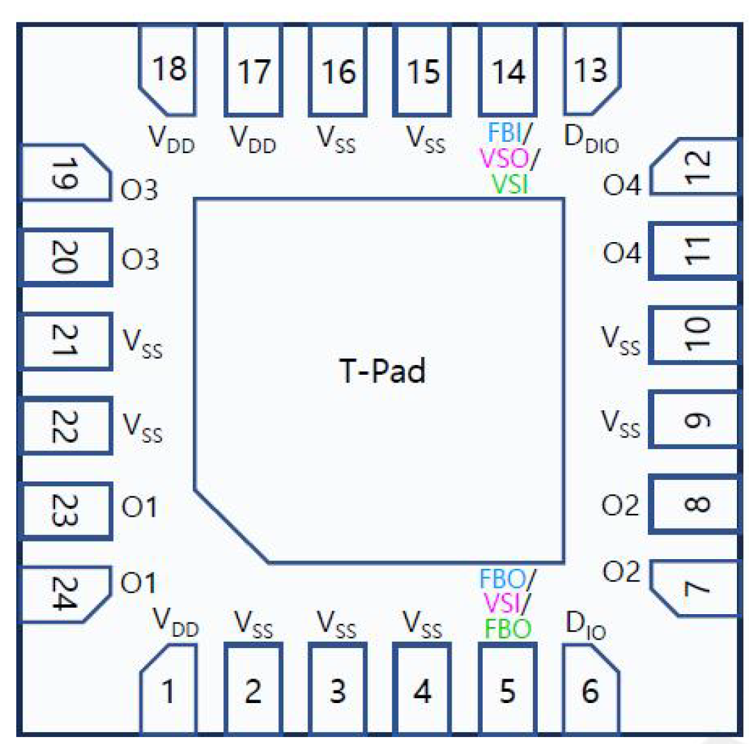
Channel Mapping
Inch | IC1 |  |  |  | IC2
50 | ch1 | ch3 | ch4 | ch2 | x | x | x | x
55 | ch1 | ch3 | ch4 | ch2 | x | x | x | x
65 | ch1 | x | ch4 | x | x | ch3 | ch4 | ch2
75 | ch1 | ch3 | ch4 | x | x | ch3 | ch4 | ch2
85 | ch1 | ch3 | ch4 | ch2 | x | ch3 | ch4 | ch2

